Slide 1

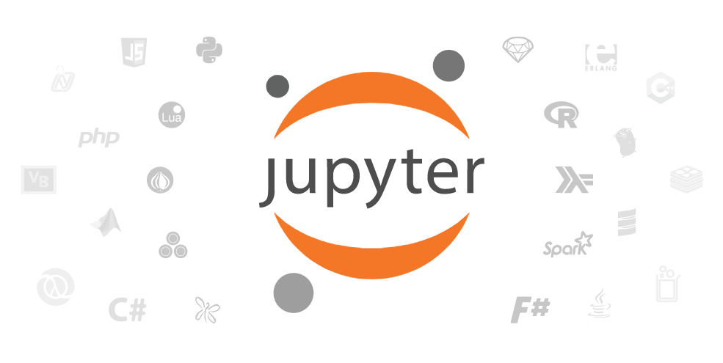
Introducing Data Wrangling and Visualization with JupyterLab, Jupyter Notebooks and Python
DOAG 2020, November 2020
Lucas Jellema, CTO & Architect AMIS | Conclusion
Notes:
To turn data into business value through insights and actions from visualizations and machine learning models, we first need to prepare the data. Data has to be gathered, cleansed, standardized, filtered, enriched, joined from many different sources into consolidated, complete and easily accessible data sets for the data scientist to work on. Jupyter Notebooks powered by Python are very popular for exploratory data analytics and data wrangling. This session introduces Jupyter Notebooks to uninitiated developers with an interest in data science and machine learning. The data set under scrutiny is the conference session catalog for a large developer conference: we will do live analysis and visualization of sessions, titles and abstracts, speakers, tracks and rooms and try a little machine learning for automated session classification as well. Summary This entire session will be one extended demo. In this demo I will introduce the Data Analysis Flow and Jupyter Notebooks as tool using some simple examples. I will then start a project with Python Powered Jupyter Notebooks/Jupyter Labs (and mention other engines and notebooks such as Apache Zeppelin) . Using the REST APIs under the Conference Session Catalog website, we will retrieve raw data on all sessions . Next we will explore the data, wrangle it and create visualizations. Using 3rd party data sets we will enrich the data - and create richer visualizations - including geographic and NLP-based (text classification) The audience will get a good understanding of the process, of the tools JupyterLab Notebook, Python and Pandas, of Plotly for visualization - and of some of the statistics of the conference under scrutiny."

Slide 2



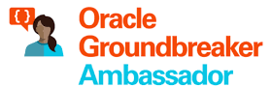
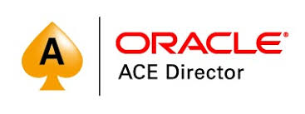


Lucas Jellema CTO for AMIS | Conclusion Cloud Solution Architect
lucas.jellema@amis.nl | technology.amis.nl | @lucasjellema | lucas-jellema

Slide 3

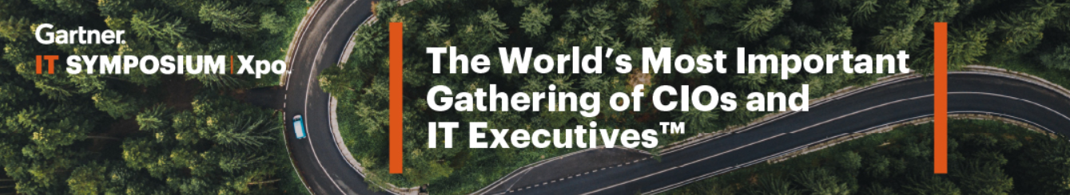
Summary of Gartner IT Symposium

Slide 4
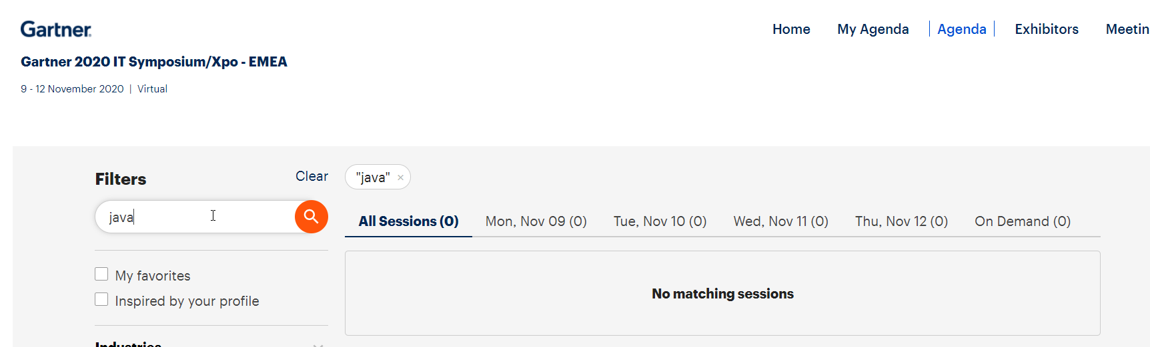
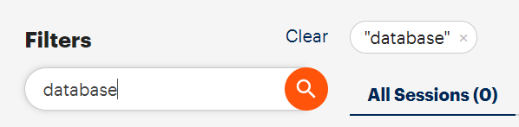
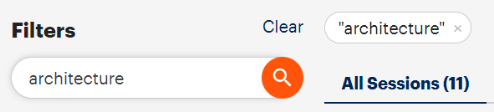
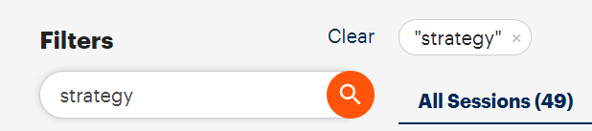
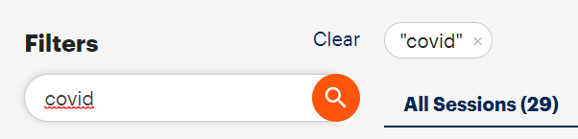
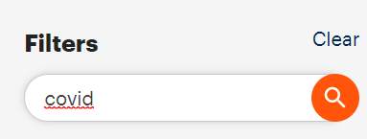
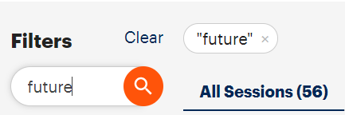

Slide 5
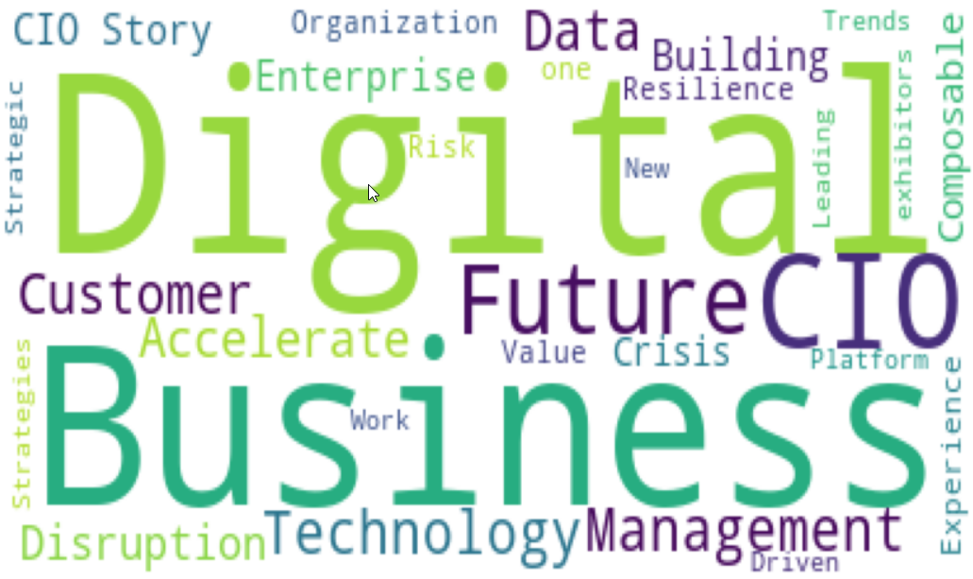

Slide 6


Slide 7
Gather Data
Wrangle Data
Explore | Analyze | Visualize | Publish Data
Store Data

Slide 8
Data Flow – from raw data to business insight & action
One time only
Periodic, in batch
Continuous, event triggered
Explore | Analyze | Visualize | Publish Data
Gather Data
Wrangle Data
Machine Learning
Deploy & Leverage
Data Warehouse
Machine Learning Model
Raw/ Operational Data Sources
Data Pipeline
Data Wrangling
“Data Mart” single purpose data set
Data Lake
Business Intelligence
Dashboard, Notification & Alert Report, Visualization, Gamification, Data Explorer
3rd party data sources
Business insight: what, when, who and why
Store Data
algorithms
Store Data
Master Data Management, Meta-Data Management, Data Governance
Data Access, Authorization, Privacy
Notes:
Iteratief – keer terug naar voorgaande stap om meer data, andere wrangling

Slide 9
[examples of] Technology in Data Flow
Python, R, Apache Spark, SQL & PL/SQL
JupyterLab Notebooks, Apache Zeppelin
NumPy, SciPy, SciKit-learn, Pandas, Bokeh, Plotly, Matplotlib, NLTK, Keras, TensorFlow, PyTorch, MXNet, Caffe, Theano
Oracle Analytics Cloud, Oracle Data Science Platform, Oracle Autonomous Datawarehouse Cloud
AutoKeras AWS SageMaker, Google AI Platform, Google AutoML, Azure Machine Learning Studio
Azure Cognitive Services, AWS AI
Oracle Autonomous Datawarehouse Cloud, AWS RedShift, Google BigData, Azure SQL Data Warehouse, Azure Data Lake Store, Oracle Database
Azure Cosmos DB, Elastic Stack, MongoDB,InfluxDB, Cassandra, AWS DynamoDB, Excel
Hadoop, Kafka, Oracle BigData Cloud
AWS S3, Oracle Storage, OneDrive, Google Storage
Explore | Analyze | Visualize | Publish Data
Gather Data
Wrangle Data
Machine Learning
Machine Learning Model
Deploy & Leverage
Data Warehouse
Raw/ Operational Data Sources
Data Pipeline
Data Wrangling
“Data Mart” single purpose data set
Data Lake
Business Intelligence
Dashboard, Notification & Alert Report, Visualization, Gamification, Data Explorer
Store Data
Store Data
3rd party data sources
Business insight: what, when, who and why
JupyterLab Notebooks, Python, Apache Spark, Java, R, Apache Zeppelin
SQL & PL/SQL, SQL Developer
SPARQL Oracle Analytics Cloud, Oracle Big Data SQL, Oracle Data Integration (OCI) , Google Cloud DataPrep, Azure Wrangler (Trifacta Wrangler) , Google BigQuery
Excel, csvkit, Pentaho
SQL, Java, Python, Node JS, JupyterLab Notebooks
SQL Developer, Apache Spark, Drill, Flink
OCI Data Integration, Oracle Integration Cloud & Cloud Adapters
Kafka, Connectors, KSQL & Streams Debezium
Azure EventHubs, Azure Data Factory
AWS Lambda, SQS, SNS, Glue, Kinesis, Step Functions
algorithms
d3.js, React D3, SVG
Oracle Analytics Cloud, JupyterLab Notebooks, Excel, SQL Developer, Oracle APEX
Pentaho, OpenStreetMap
Azure PowerBI, AWS QuickSight
Tableau, Qlik, Looker,
SAP Analytics (Business Objects), IBM Cognos, SAS, Tibco JasperSoft
Kibana, Grafana
Turn Data into Business Value - Starting with Data Analytics on Oracle Cloud

Slide 10
[examples of] Technology in Data Flow
Python, JupyterLab Notebooks
JSON files in file storage
Machine Learning
Deploy & Leverage
Data Warehouse
Machine Learning Model
Raw/ Operational Data Sources
Data Pipeline
Data Wrangling
“Data Mart” single purpose data set
Data Lake
Business Intelligence
Dashboard, Notification & Alert Report, Visualization, Gamification, Data Explorer
3rd party data sources
Business insight: what, when, who and why
JupyterLab Notebooks,
Python, JupyterLab Notebooks
algorithms
JupyterLab Notebooks
Turn Data into Business Value - Starting with Data Analytics on Oracle Cloud

Slide 11
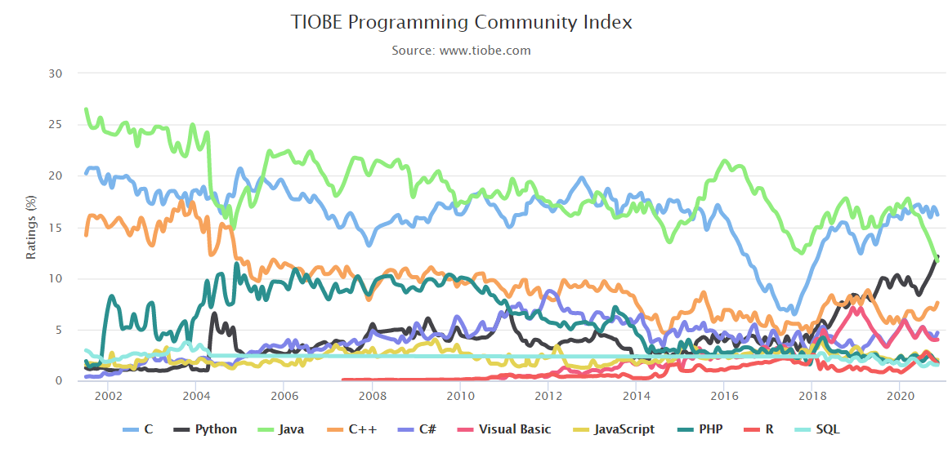
TIOBE Programming Community Index

Slide 12
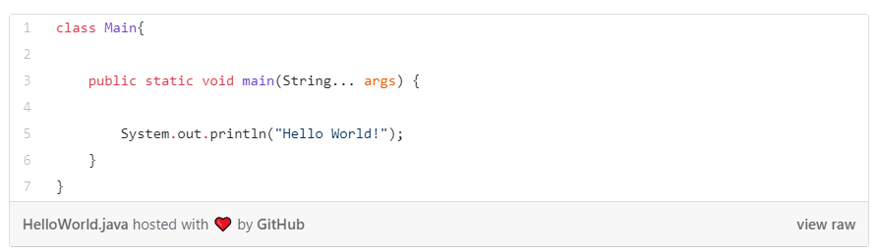
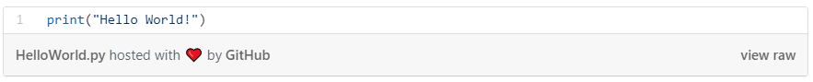
Advantages of Python
Easy to learn Easy to read. Quick to grasp for beginners. The focus is on solving a problem, not on the complexity of the syntax. Little time and effort required to produce first script.
Python runs on all major operating systems and platforms.
Many tutorials & support in communities
Java:
Python:

Slide 13
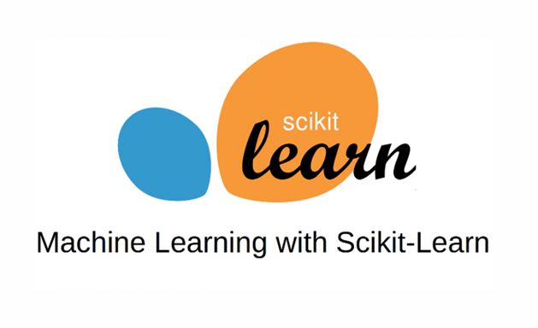



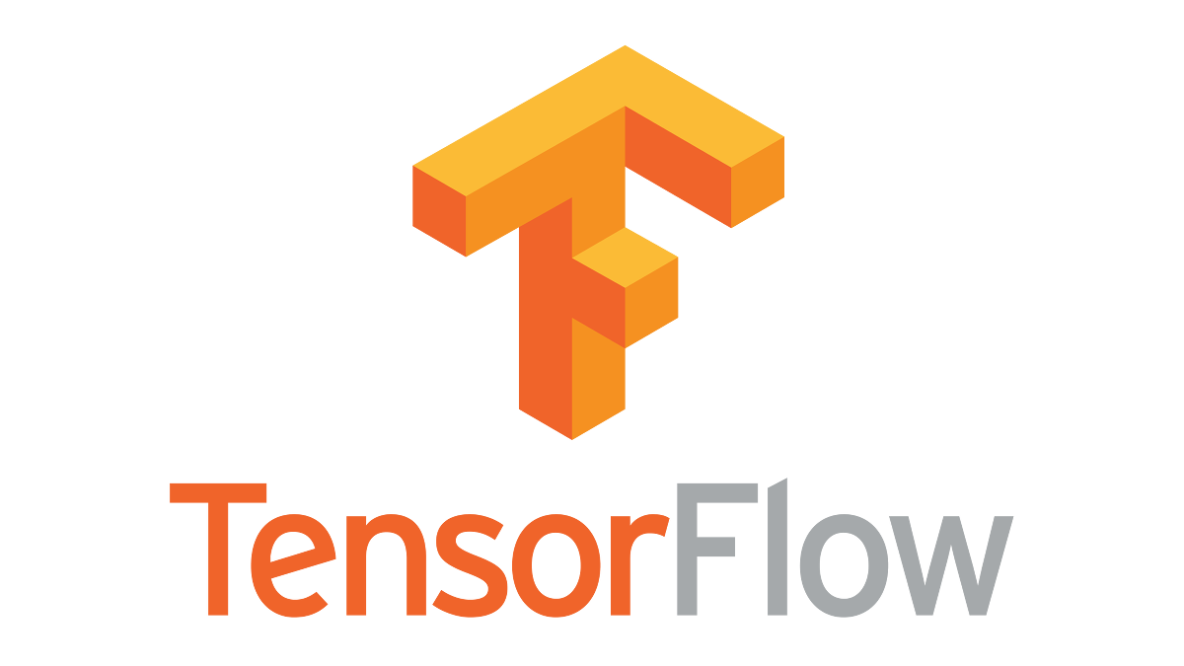
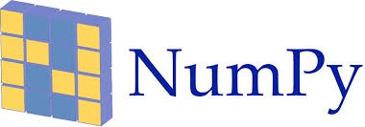



Data Science & Machine Learning in Python
Focus on data preparation, data visualization, data analysis and machine learning with Python Python supports all these steps:
Data preparation
Analysis & machine learning
Data visualization

Slide 14
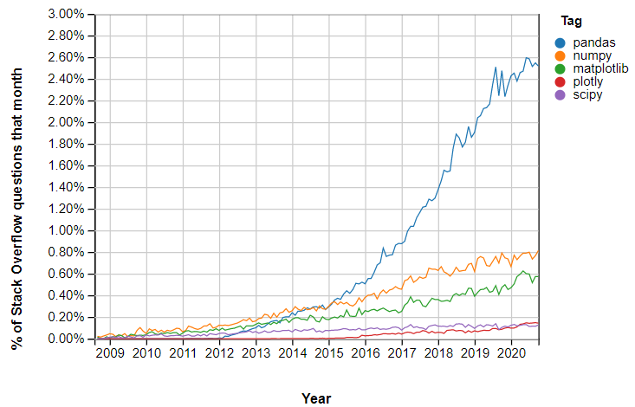
Python Libraries
Notes:
https://insights.stackoverflow.com/trends?tags=pandas%2Cnumpy%2Cmatplotlib%2Cplotly%2Cscipy

Slide 15

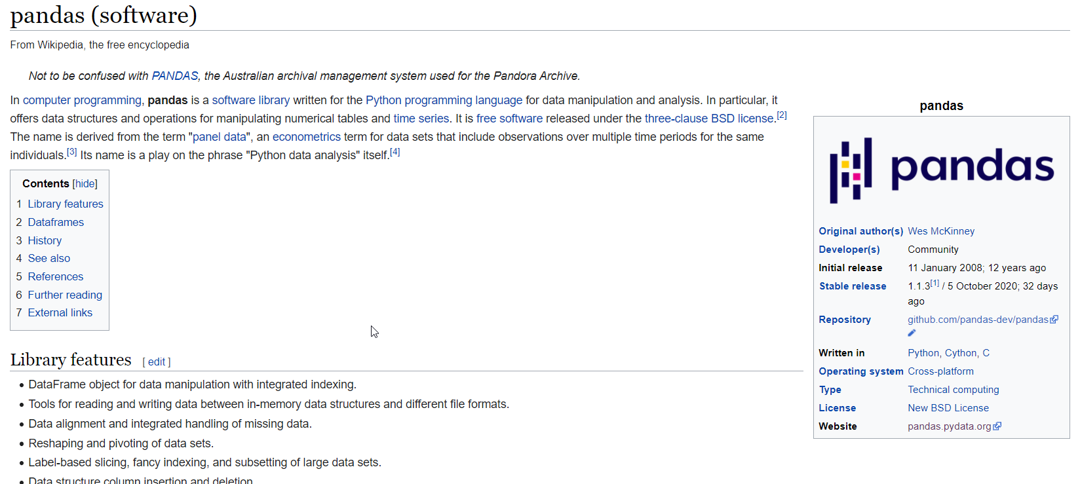
Notes:
Shift + tab (+ tab ) == help!!
Tab = autocomplete
Use ? To get docs on module (venn2? And ctrl+enter)

Slide 16

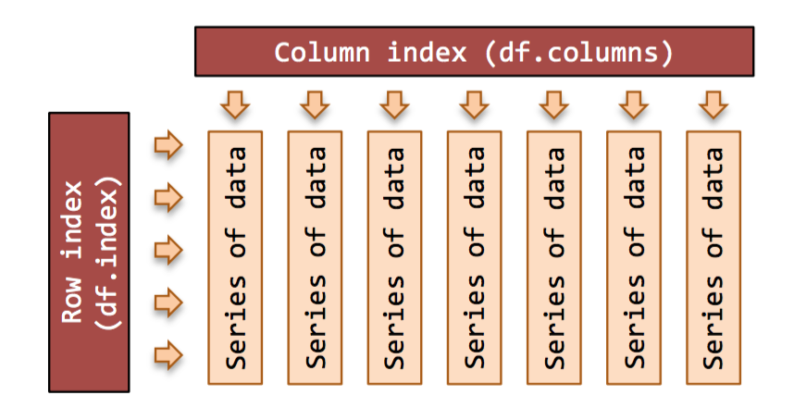
Data preparation in Python: Pandas
Data preprocessing takes most of the time in a data analysis (80%). The tool to prepare data effectively: pandas. Powerful tool of Pandas: data frame (equivalent to data.frame in R). Multidimensional data structure consisting of rows and columns. Each column is defined as a data type. Easily filter and create subsets. Focus on data analysis: lots of features available.
Notes:
Pandas: panel data (economische term voor multidimensional gestructureerde dataset)

Slide 17
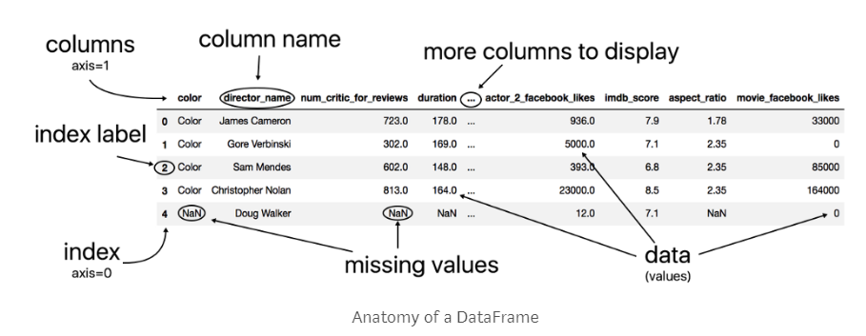
Pandas = Panel Data
Notes:
Learn pandas: https://medium.com/dunder-data/how-to-learn-pandas-108905ab4955
10 minutes to pandas: http://pandas.pydata.org/pandas-docs/stable/10min.html
https://towardsdatascience.com/pandas-dataframe-a-lightweight-intro-680e3a212b96

Slide 18
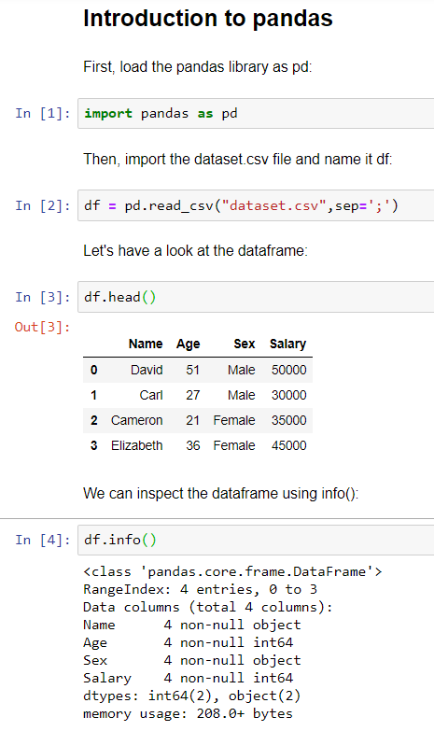
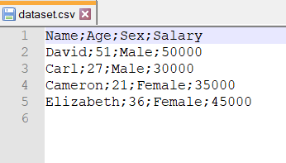
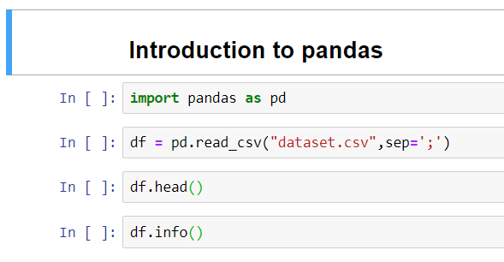
Pandas in Python
Dataset.csv:
Python script:

Slide 19
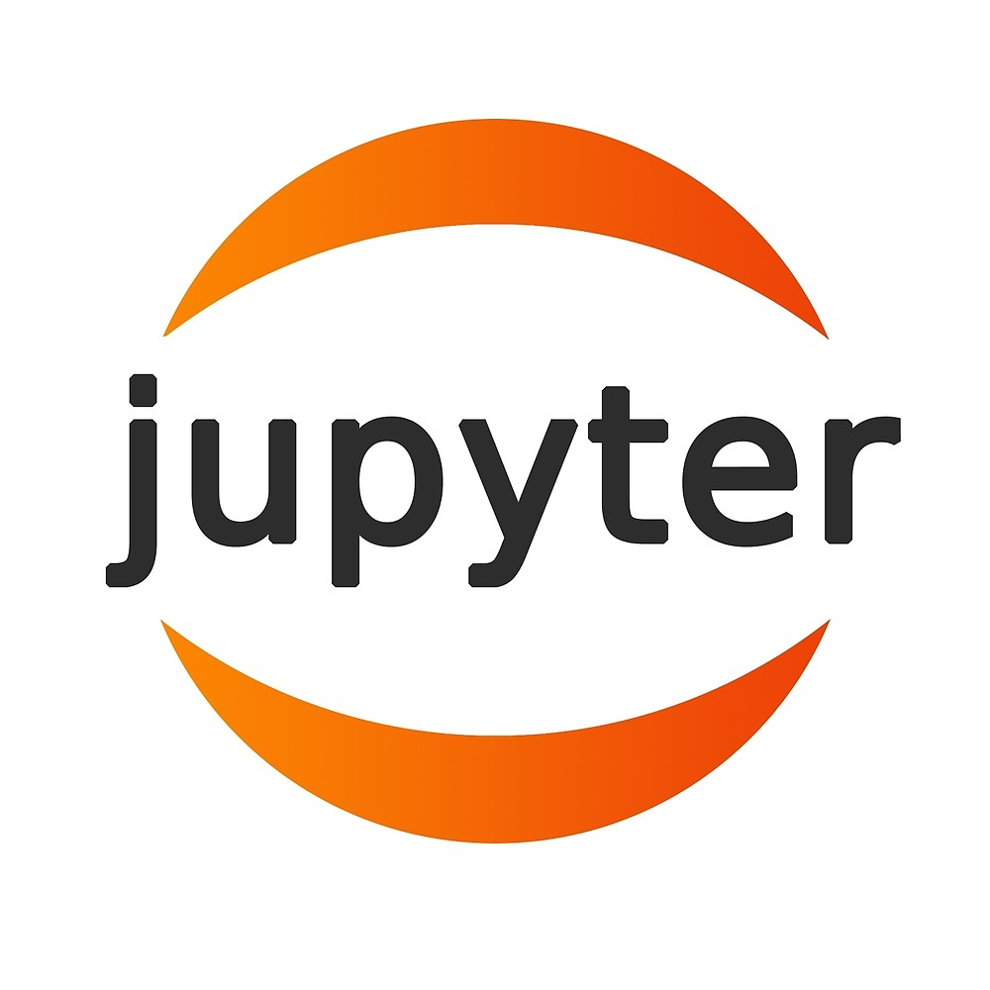
Would it not be great…
If we had a tool that
works like a Wiki
allows us to write down ideas, experiments, findings
supports adding code snippets
can load data and manage variables
executes code snippets
supports Python and Pandas (and other Python libraries for data engineering, visualization, machine learning,… )

Slide 20
What is a Jupyter Notebook?
A notebook is a document that can contain both code and rich-text elements (figures, tables, equations, images, etc.). Ideal for storytelling: a notebook is great for analysis: the document can contain a problem description, a data analysis and the results of the same research.
Jupyter: acronym for Julia, Python and R. Supports, among other things, the following programming languages (via 'kernels’): Julia, Python, R, Scala, Fortran, Ruby, C++, C#, Go, Torch, Perl, Matlab, PHP, Java, Stata, SQL, etc.....

Slide 21
JupyterLab succeeding Jupyter Notebooks
JupyterLab arrived on the scene in February 2018; Release 1.0 in June 2019
Jupyter Notebooks was started in 2015
and itself was a spin off from IPython – which started in 2001
Jupyter Notebooks are included in
Oracle Data Science (on OCI)
Azure Databricks, Azure Machine Learning & Azure Notebooks (preview)
AWS Deep Learning & SageMaker
GCP AI Platform Notebooks
MyBinder.org
nbviewer
Notes:
JupyterLab Releases
Since JupyterLab 0.32 (February 2018), the releases of JupyterLab are suitable for general daily use by both Jupyter novices and users experienced with the Classic Notebook interface. As of the 1.0 release (June 2019), it is additionally ready for extension writers who wish to further customize the JupyterLab experience for others. Please review the JupyterLab Changelog for detailed descriptions of each release.
The extension developer API is evolving, and we also are currently iterating on UI/UX improvements. We appreciate feedback on our GitHub issues page as we evolve towards a stable extension development API.
JupyterLab will eventually replace the classic Jupyter Notebook. Throughout this transition, the same notebook document format will be supported by both the classic Notebook and JupyterLab.

Slide 22
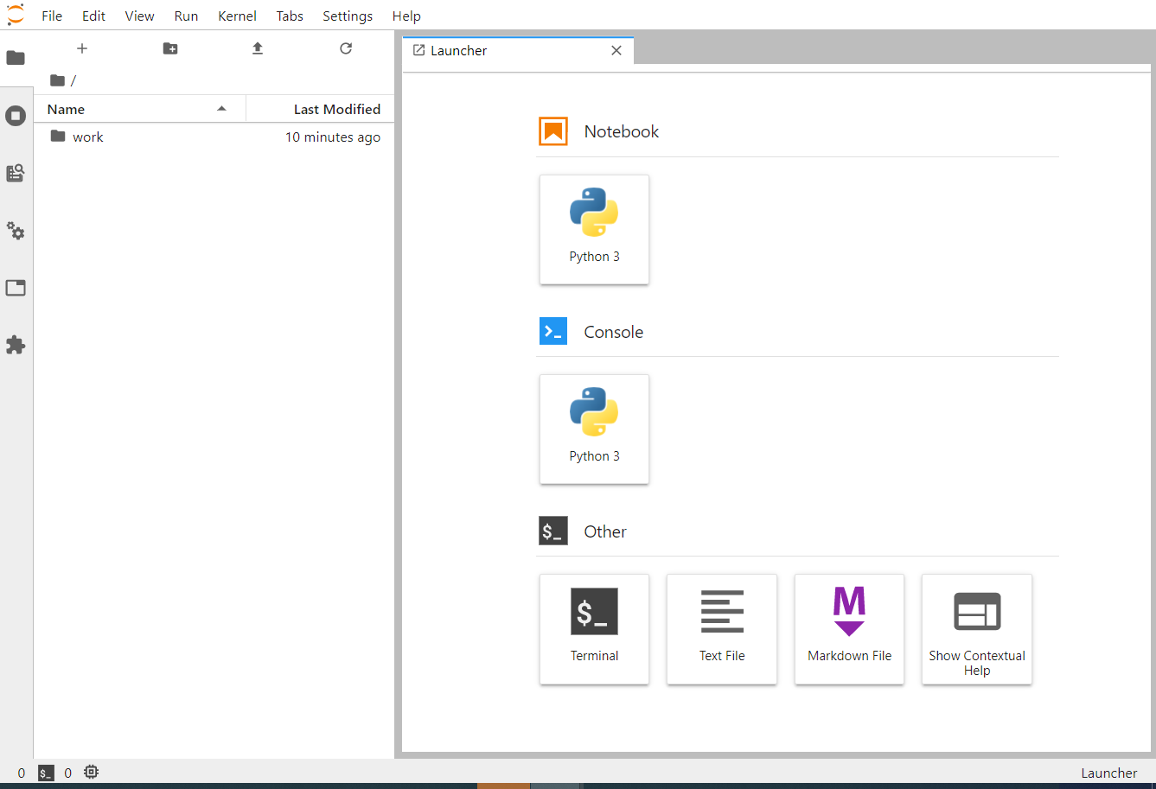
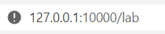
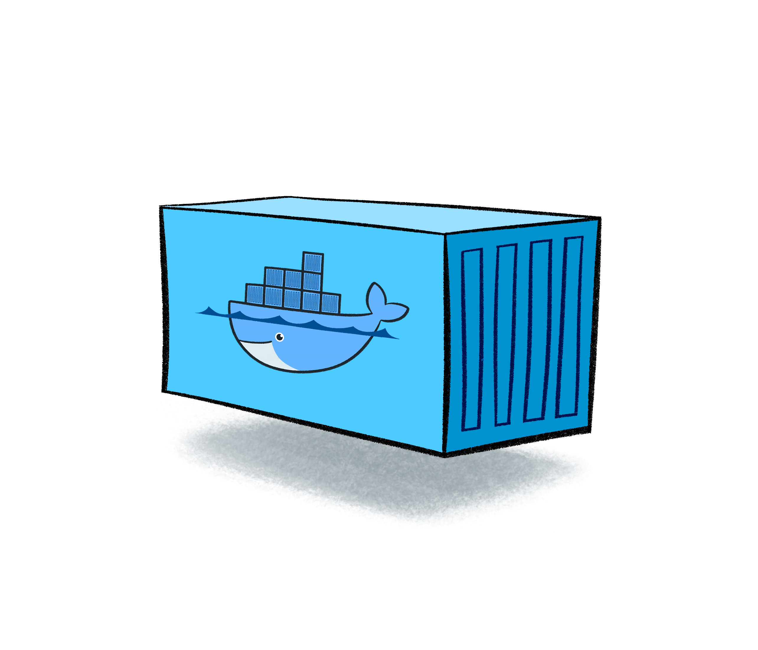
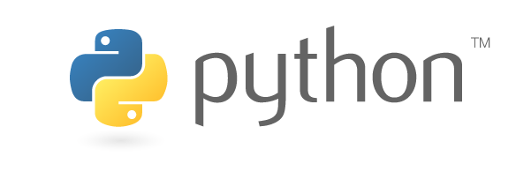
Running JupyterLab with Notebooks embedded
Run container
Open browser at host:port/lab
Work directory inside container is mapped to working directory from which container is run
docker run --rm -p 10000:8888 -v "$PWD":/home/jovyan/work -e JUPYTER_ENABLE_LAB=yes jupyter/minimal-notebook
Notes:
docker run --rm -p 10000:8888 -v "$PWD":/home/jovyan/work -e JUPYTER_ENABLE_LAB=yes jupyter/minimal-notebook
under WSL2: /tmp => /work
under Windows:
Open File Explorer
Type \\wsl$ in the address bar
navigate to
\\wsl$\Ubuntu-20.04\tmp
# Install pandas (without SSL)
pip install --trusted-host pypi.org --trusted-host files.pythonhosted.org pandas

Slide 23
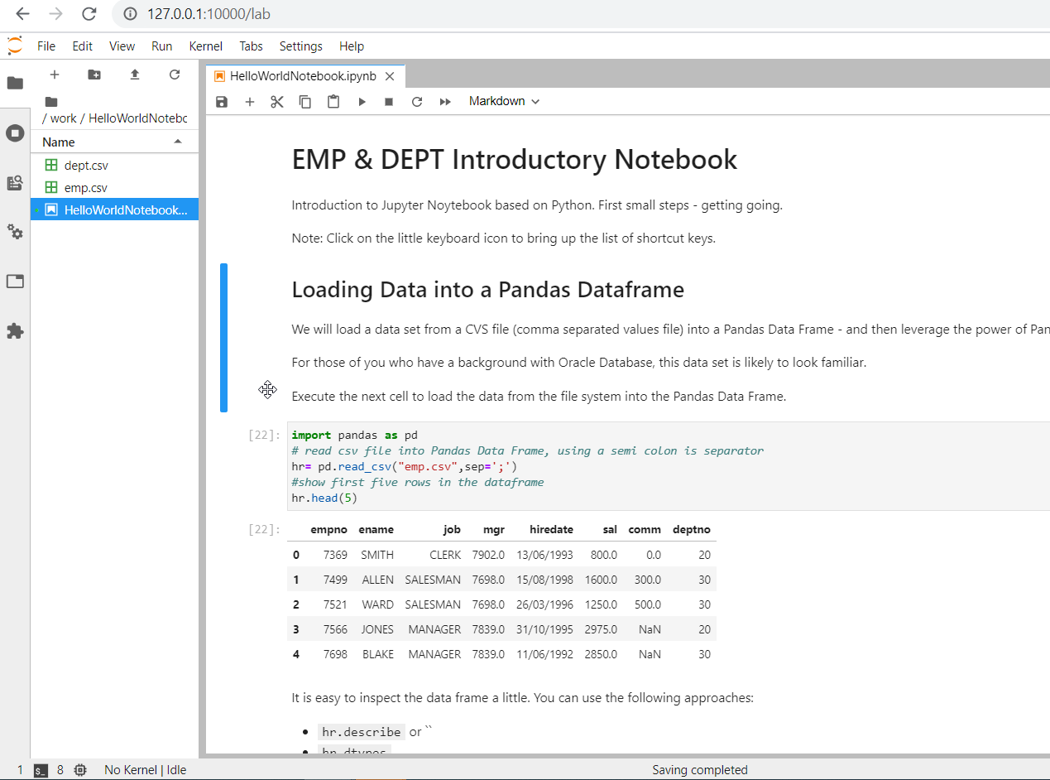

Slide 24
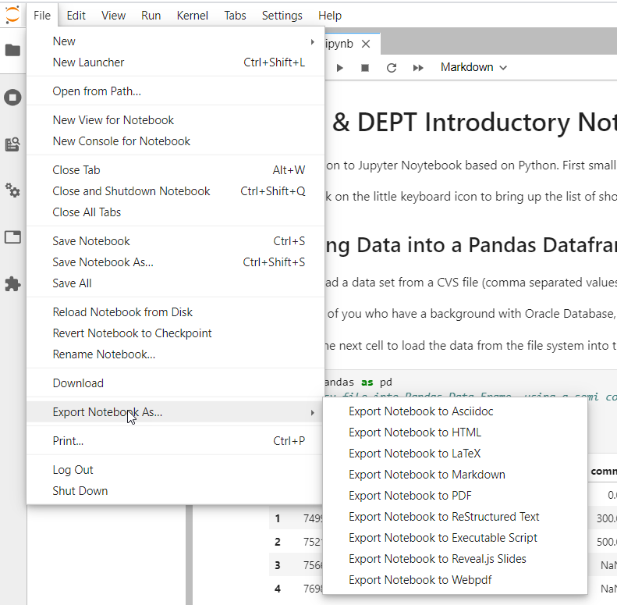

Slide 25
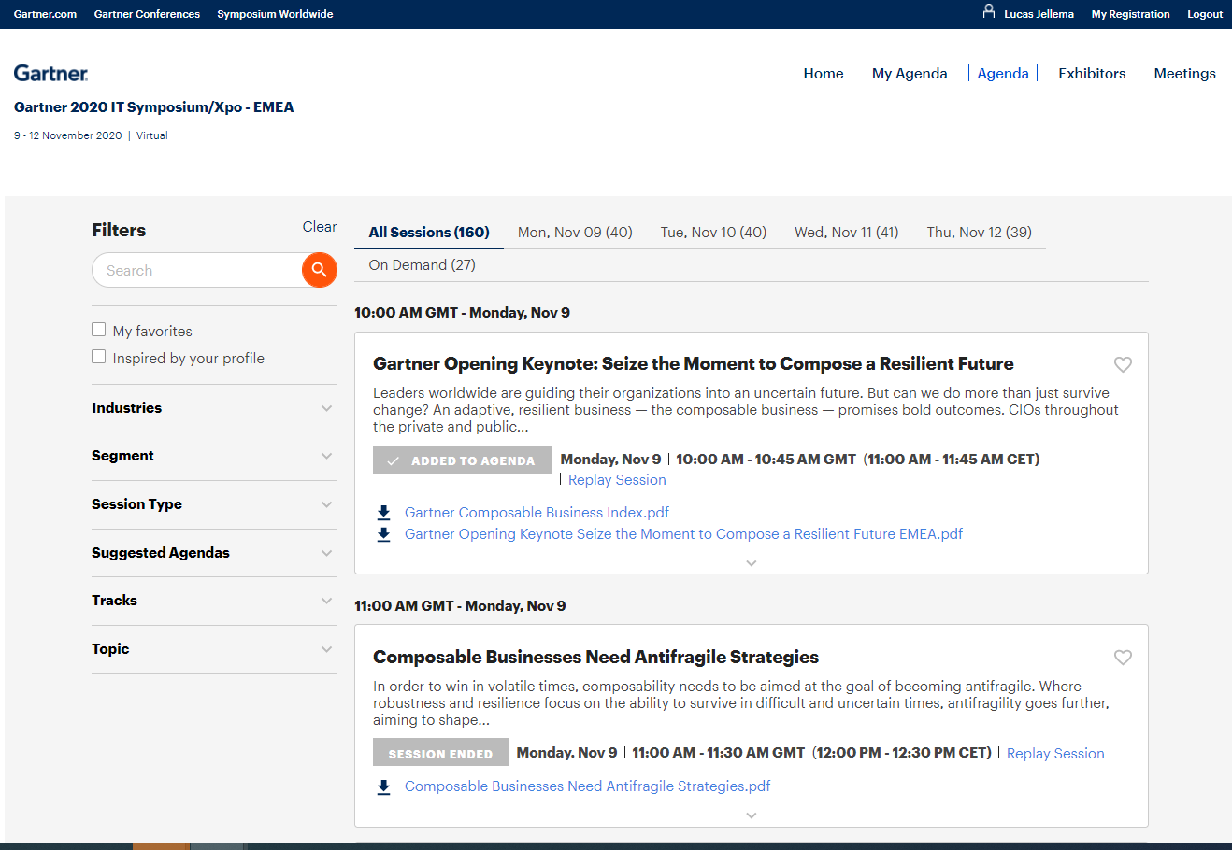

Slide 26
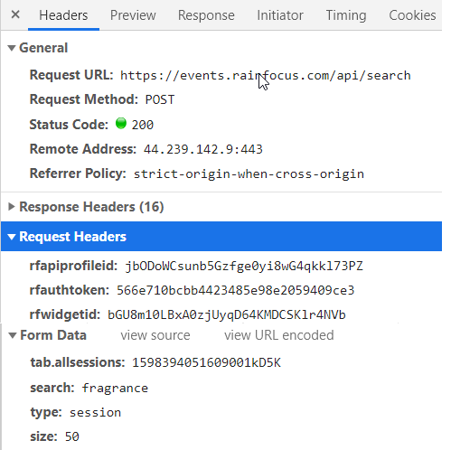
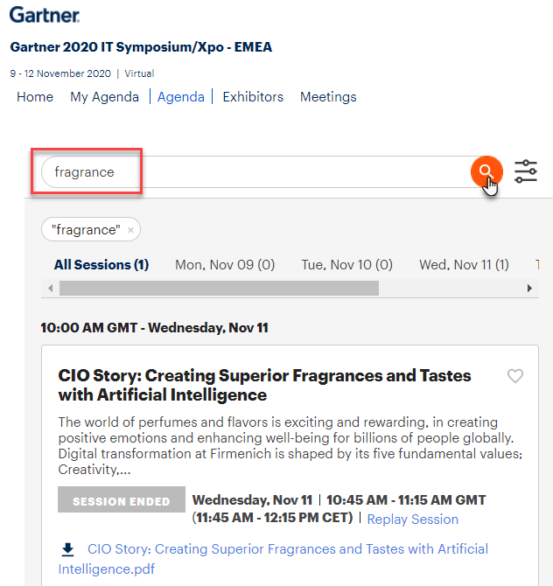

Slide 27
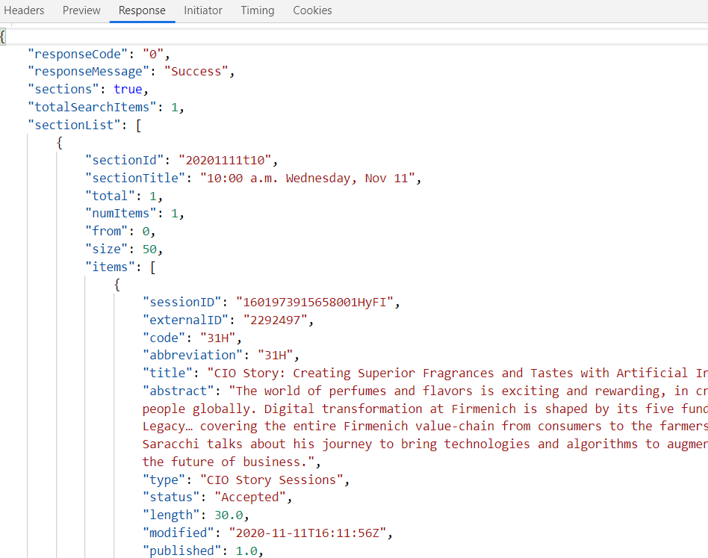

Slide 28

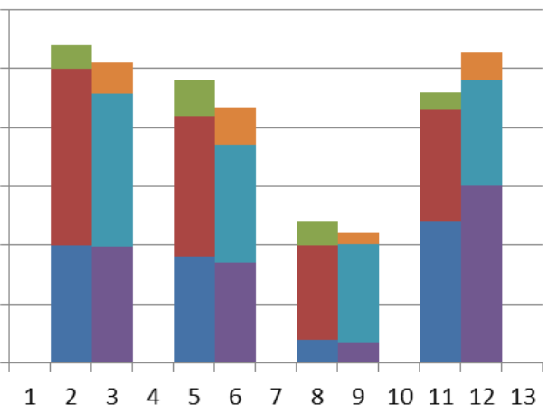
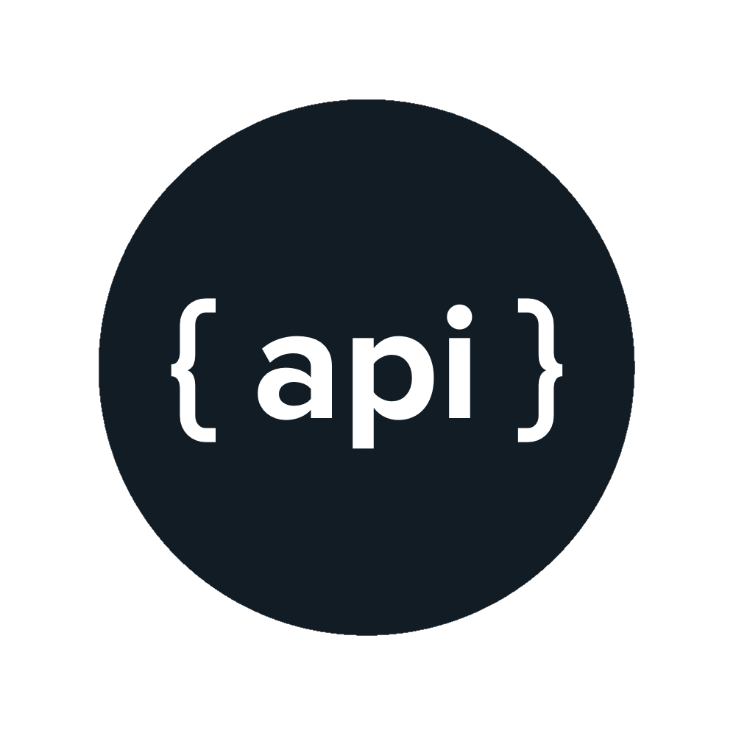
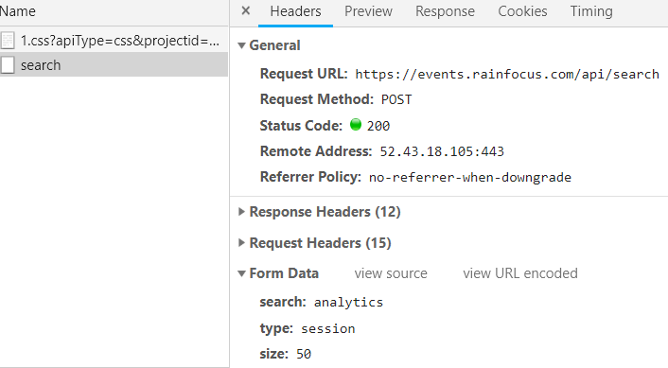
Flow for Gartner IT Symposium 2020 Session Data Analytics
Data Gathering
Data Wrangling
Business Intelligence
Report & Visualization on Speakers
API for session details in JSON
Report & Visualization on Sessions
Machine Learning
AMIS Kick Off 2019 - Proposities & Data Analytics

Slide 29
Flow for Gartner IT Symposium 2020 Session Data Analytics
3
Exploration of Conference Speakers , visualizations, business insights and answers.
1
2
From Raw, External, Slow/Unavailable Data
to local, accessible, still fairly raw Data Lake
To a consolidated, cleansed, formatted, unified Data Set with derived and enriched values
Gender guesser
Jupyter Notebook & Python
Report & Visualization on Speakers
API for session details in JSON
Jupyter Notebook & Python
Jupyter Notebook & Python
JSON file
JSON files
Jupyter Notebook & Python
Report & Visualization on Sessions
AMIS Kick Off 2019 - Proposities & Data Analytics
4
Exploration of Session Details, visualizations, business insights and answers.

Slide 30
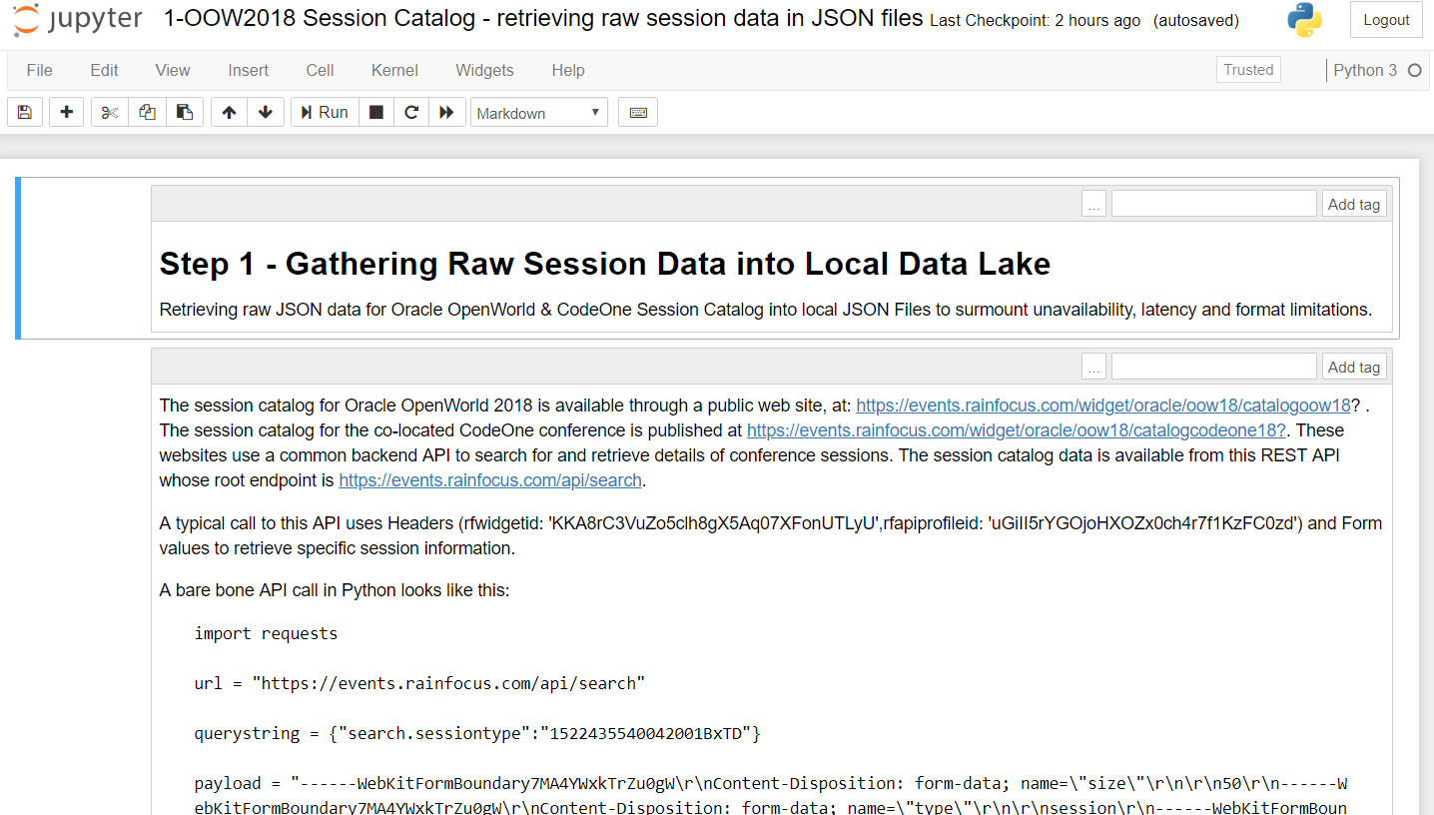
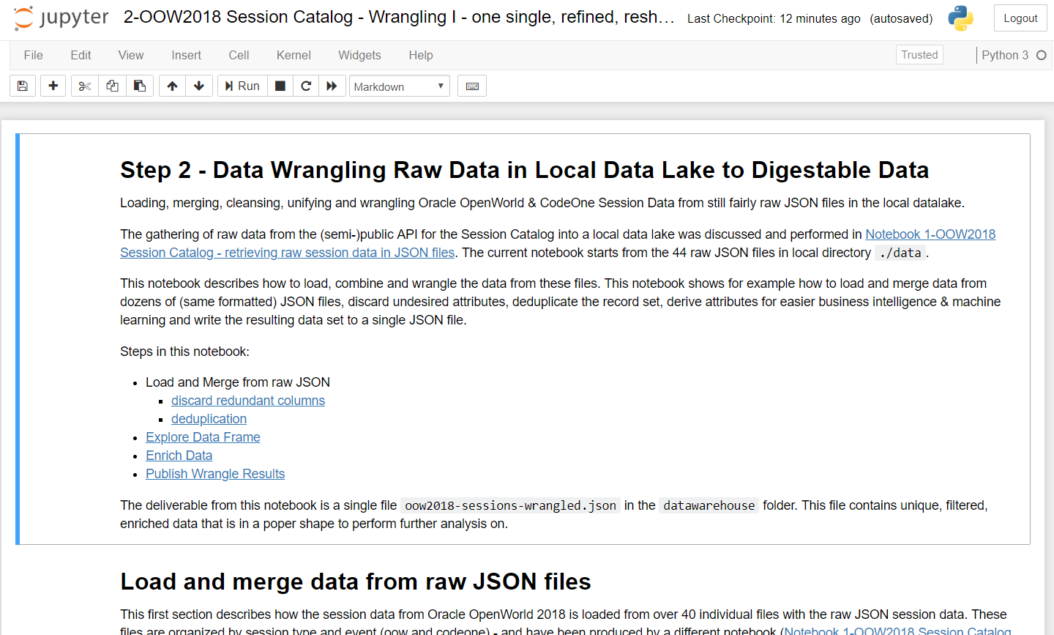
Flow for Gartner IT Symposium 2020 Session Data Analytics
Speakers:
Read JSON file, extract speaker details, visualize and analyze speaker data
Read all JSON files, discard unneeded attributes, derive new attributes, deduplicate records and write to a single local JSON file
Fetch all raw session data and write to local JSON file
Gender guesser
Jupyter Notebook & Python
Report & Visualization on Speakers
API for session details in JSON
Jupyter Notebook & Python
Jupyter Notebook & Python
JSON file
JSON files
Jupyter Notebook & Python
Report & Visualization on Sessions
gartner-2020-sessions-wrangled.json
AMIS Kick Off 2019 - Proposities & Data Analytics
Sessions:
Read JSON file, visualize and analuyze session data
/datalake
/datawarehouse

Slide 31
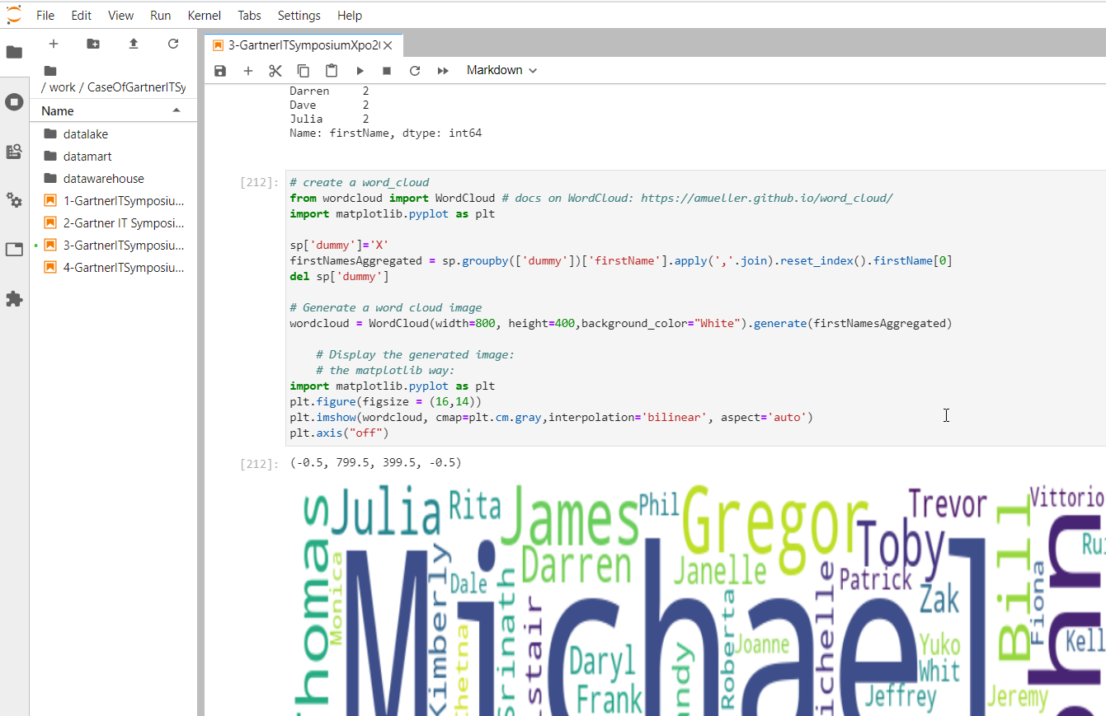

Slide 32
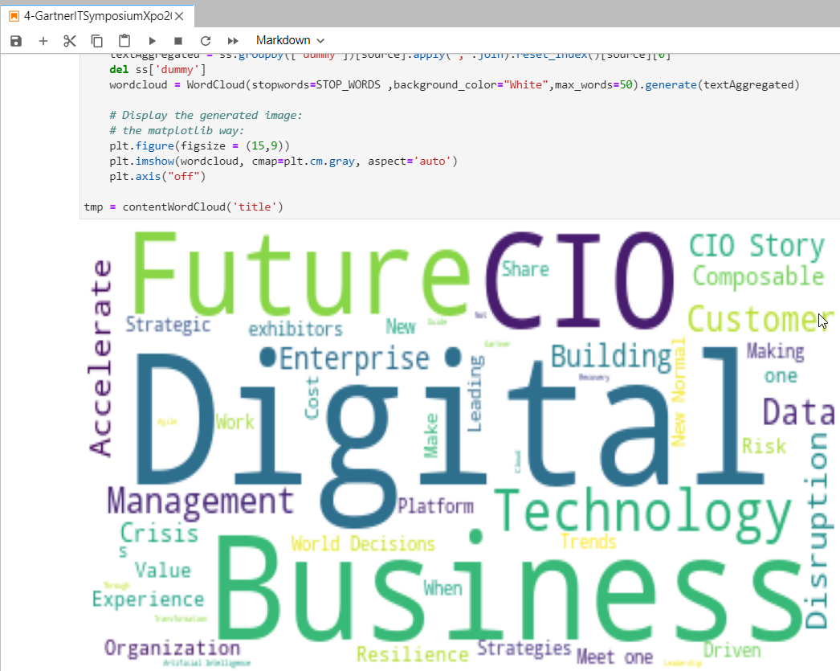

Slide 33
Conclusion
Data can unlock value
To retrieve the value, we must:
gather, wrangle, analyze | visualize
Data Analytics & Data Science consists of a great deal of trial and error
and data preparation | wrangling is a large part
Python is the most popular language for data engineering & exploration
Pandas is a powerful library
JupyterLab Notebooks are a great data workbench
powered by Python and Pandas (and others)
easy (and fun) to use

Slide 34
Thank you for your attention
lucas.jellema@amis.nl | technology.amis.nl | @lucasjellema | lucas-jellema

